Slide 1
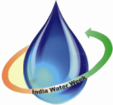
INDIA WATER WEEK 2013
09 April 2013, New Delhi
SESSION S4:
PARTICIPATORY IRRIGATION MANAGEMENT AS A TOOL FOR IMPROVING WATER USE EFFICIENCY
RESTORATION OF TRADITIONAL WATER RESOURCES (LAKES) WITH LOCAL PARTICIPATION FOR COPING UP WITH CLIMATE CHANGE
B. Sada Siva
Team Leader
DHAN Foundation, Hyderabad

Slide 2
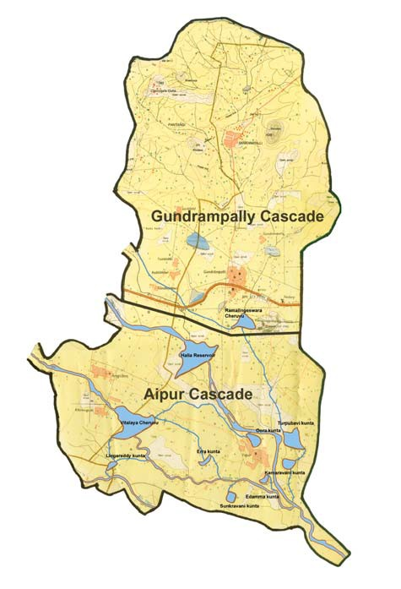
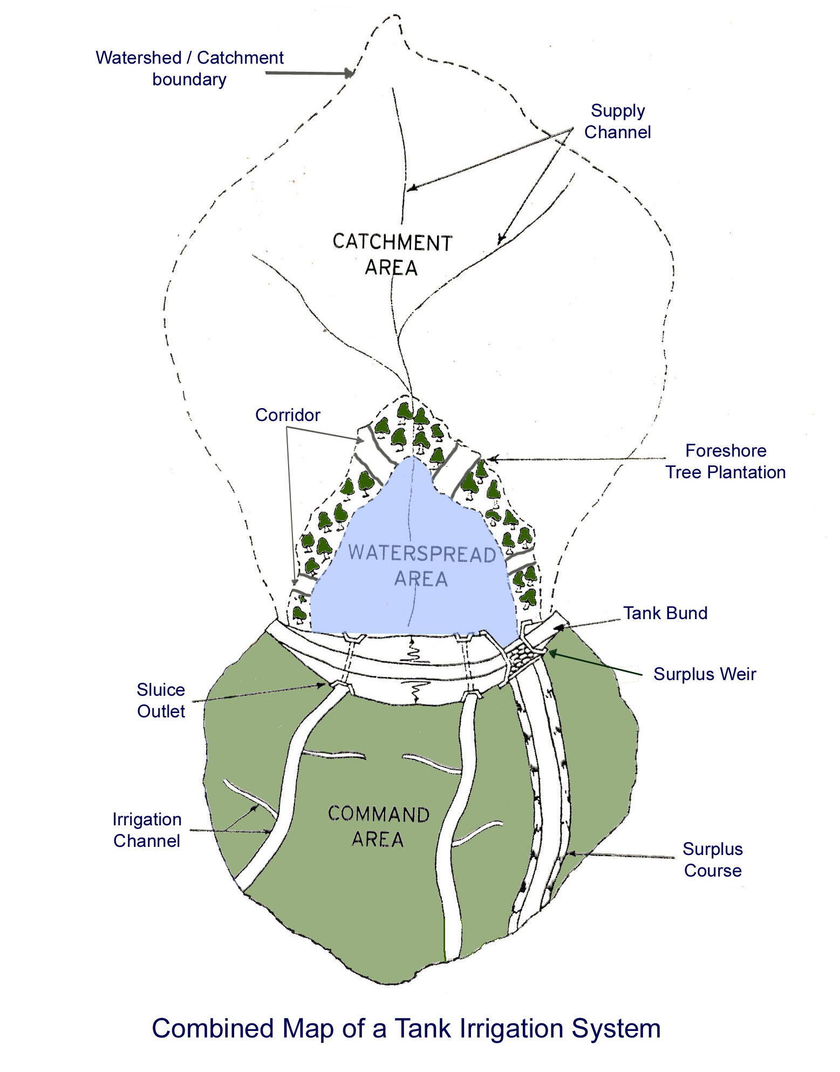
Conservation and Development of Traditional Irrigation Commons (Tanks) for Livelihood Promotion
DHAN Foundation

Slide 3
Introduction :Significance of tank cascades
DHAN Foundation
Visible Impact in a group of tanks than single tank.
Surplus water in upper tanks flows to lower tanks in the cascades
Considerable storage and utilization efficiency
Good system functioning and very high performance efficiency
To maximize the benefits from the investment (labour, money, etc.)
To restore the social harmony in
villages linked by the tank cascade.

Slide 4
Significance of tank cascades
DHAN Foundation
Any investment of rehabilitation made on a single tank in a cascade does not serve its purpose fully
A tank cascade could be a good development unit like watershed for effective conservation and management for developing rural marginalised community
Tank associations (WUA) at a cascade level will facilitate effective water sharing as well as managing the conflicts arising between tanks within the system
Risk of tank cascades
A breach in an upper tank would lead to the risk of similar failure in other lower tanks
Repairs and restoration works to all the tanks in a cascade at a time is necessary

Slide 5
Activities undertaken
DHAN Foundation
Promoting farmers organizations (WUA)
Initiating savings and credit with tank Association members
Support for tankfed agriculture
Creation of endowment funds for the people institutions

Slide 6
Process followed
DHAN Foundation
Orientation meetings in the villages with the stake holders
Capacity building events
Participatory Tank Appraisal (PTA) / Transact walk for all tanks
Tank Associations (TA) promotion (WUA)
Prioritization of works for the rehabilitation
Technical estimates preparation
Adm. & Technical sanctions from DWMA, Nalgonda
Farmers contribution mobilization (25%)

Slide 7
Nested Institutions – The Vayalagam Way
DHAN Foundation
Tank Associations (WUA)
Promotion
Hand holding
Fund raising & routing
Techno managerial Support
Training
Program Support
Institution Building
Fund raising & routing
Capacity Building
Tank Cascade Association
Block Tank Federation
DHAN Foundation
Funding & Evaluation
Progress Report
Panchayats
Funding & Evaluation
Progress Report
District Rural Development Agency/ Other Government Agencies/ Banks
Tank Conservation Movement

Slide 8
Impact
DHAN Foundation
Revived 17 tanks with people participation in 2 Tank cascades
Increase in water availability- From 65 days to 100 days
3,695 person days generated during work execution
Ayacut areas of the tanks stabilized and Increased productivity and Livestock promotion.
Inter and intra village collaboration developed.

Slide 9
Success of the implementation
DHAN Foundation
People contribution – 25% due to cascade approach
Direct stakeholders’ participation in works execution
Creation of endowment fund for the sustainability of the Associations (WUAs)
Availability of credit for agriculture through Micro Finance Groups
Technical Support through Agl. Dev. Centres
Need based trainings to the stakeholders
Exposure visits to suitable locations
Trainings to community mobilisers
Need based and priority wise implementation of works
Other civic activities intervention

Slide 10
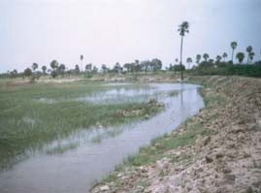
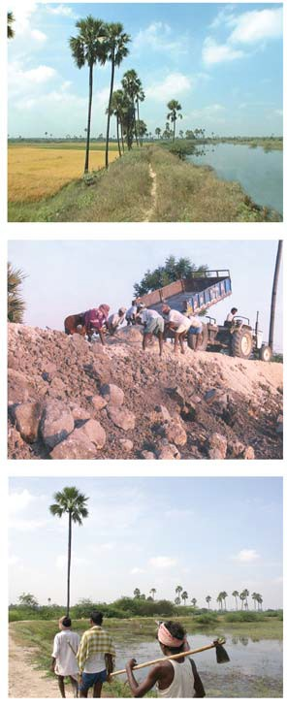
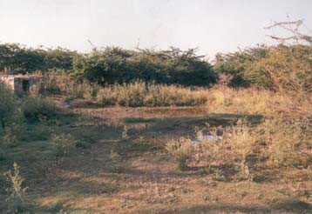
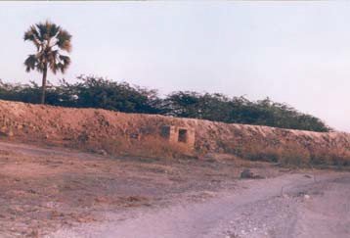
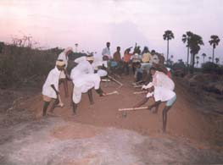
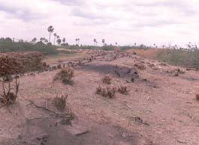
DIFFERENT PHOTOGRAPHS DURING RESTORATION
DHAN Foundation
Sluice before renovation Sluice after renovation

Slide 11
Challenges and Way forward
DHAN Foundation
Encroachment eviction
Inadequate funds allocation for tank rehabilitation
Associations to get usufruct rights with Grama Panchayats
Way Forward
Tanks rehabilitation-cascade basis
Undertaking detailed studies on the impact of the tank rehabilitation on the livelihoods of the poor.
Thank You !

